Slide 1
Wood Byproduct and Residual Markets in Appalachia
Joseph F. McNeel, Curt Hassler
& Shawn Grushecky
Appalachian Hardwood Center
West Virginia University

Slide 2
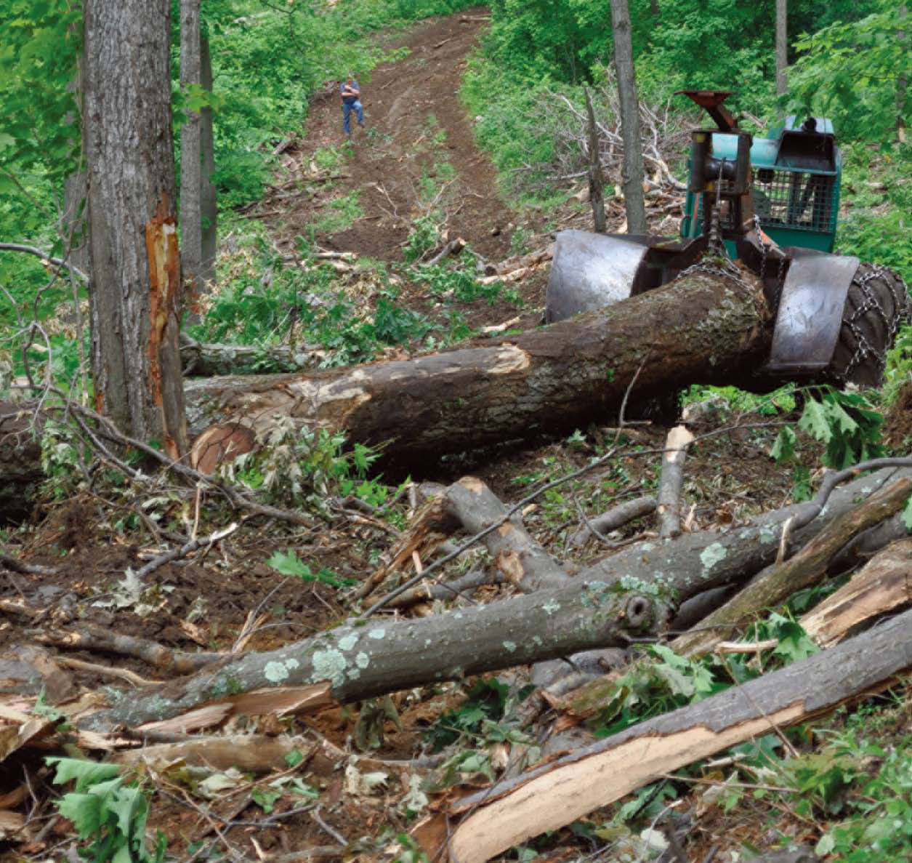
Just to confirm…
No Biomass Harvests
No Energy Harvests
Small wood goes to
Pulp Mills or OSB Mills

Slide 3
Market Structure of Wood Byproduct Markets – Emphasis on Hardwoods
Most often, the market has a large number of sellers (wood products companies) and a small number of buyers (Oligopsony)
Sellers often have a set level of production that is dependent on the amount of primary (valuable) product they create.
Market volatility is pretty common and can lead to problems!
And finally, if a byproduct can’t be sold it becomes a cost of production, rather than a profit or break-even option!

Slide 4
Facts about Residuals…
No manufacturing plant is in business to make residuals.
Residuals, or byproducts, are produced every day as a part of the manufacturing process regardless of whether you have markets for them or not!
Consistent markets are an absolute necessity, but are not always available!
Recent market shifts suggest that significant instability occurs when individual buyers fall out of the market…

Slide 5
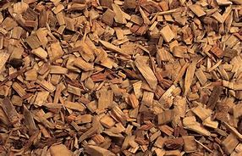
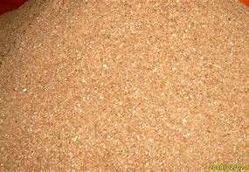
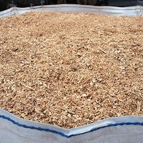
Primary Processing Residuals
Green Chips
Bark
Green Sawdust
Secondary Manufacturing Residuals
Dry Sawdust

Slide 6
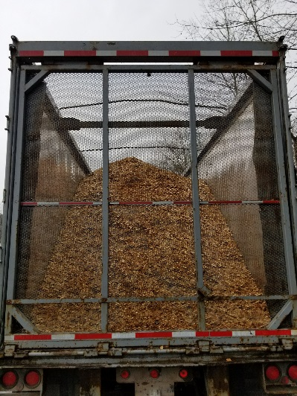
Green Hardwood Chips
Primary markets:
Paper mills,
OSB mills
Secondary markets:
Hardwood pellets
Metallurgical processes
Hardwood chip markets are typically the most stable markets in the sawmill residual markets – unless pulp or OSB mills drop out…

Slide 7
Green Hardwood Sawdust
Possible primary markets:
Hardwood pellets
Charcoal
Boiler fuel
Activated carbon
Sawdust markets are generally less stable than chip markets…

Slide 8
Green Hardwood Bark
Possible primary markets:
Hardwood mulch - Very seasonal
Charcoal
Hog fuel – Added equipment costs
Hardwood bark markets are the least stable of all the sawmill residual markets.

Slide 9
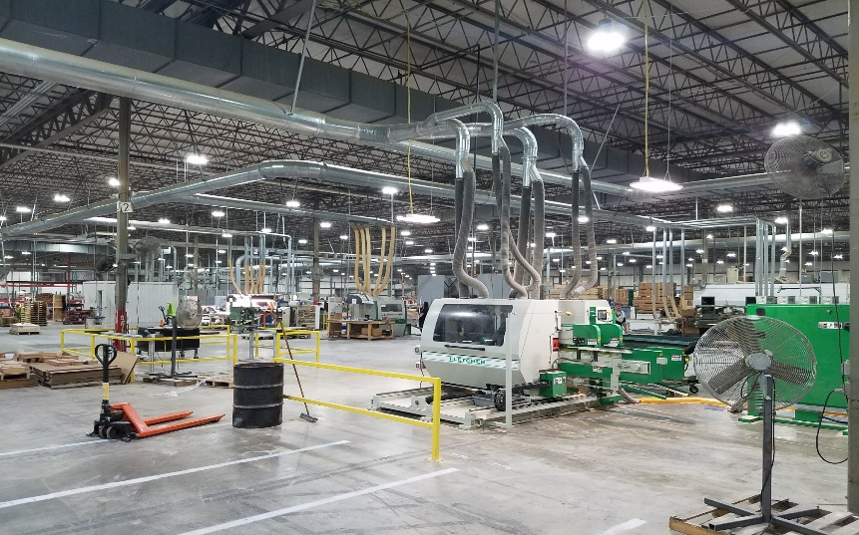
Secondary Processing Residuals Dry Hardwood Sawdust, etc…
Includes sawdust, planer shavings, and sander dust
Possible primary markets
Hardwood pellets
Hardwood briquettes
Hardwood composite lumber
Animal bedding
Boiler fuel
Dry residuals tend to be either very valuable or worthless depending upon market availability
Pellet Mill at the AWP site
in Kingwood, WV

Slide 10
Summarizing the markets…
A large number of byproduct forms with a variety of end use markets,
Energy focus of some markets that use wood byproducts – pellet fuel, charcoal, boiler fuel, etc…
Very limited markets – restricted largely by location of demand sector,
Poorly understood markets that are critical to the primary and secondary wood product sectors across the US – both softwood and hardwood.

Slide 11
Byproducts Survey
Concern over significantly reduced demand for common byproducts in 2017 in Appalachia – Mills couldn’t get rid of their “waste” material…
Collected data from four state region – PA, WV, OH, and MD. Called first to confirm mill existence and verify participation…
We had just under a ten (10) percent response to the survey. Responses were very interesting and provide insight to the market and its fragility…

Slide 12
Reported Production (Percent Of Total Production) for 73 Responding Mills by Type of Residue/Byproduct

Slide 13
Total Residues Produced Relative To Average Consumption Of Logs For 45 Sawmills Surveyed.
Total residues produced (tons/week)
RESPROD = A + B(X)
Log Consumption (MBF/Week)

Slide 15
What Recent Changes In The Byproduct Markets Significantly Affected Demand?
Survey says…
Lower fossil fuel prices 13 responses
Warmer winters 12
Pellet fuel production down 6
Paper production down 6
Over-supply of byproducts 6
User markets/business closed 3
And, of course,…
Wall Street criminals 1
Obama 1

Slide 16
Are You Purchasing Byproducts From Outside Suppliers To Supplement Your Own Production In Order To Generate Heat, Steam, And Electricity?
(56 mills responded)

Slide 17
Purchasing Byproducts From Outside Suppliers To Generate Heat, Steam, And Electricity
About 96 percent of the 56 survey respondents indicated that they were buying “waste” from outside sources to augment their own supply, probably to augment heat/steam generation to kilns.
Another reason for buying this additional byproduct material is to feed on-site boilers or co-gen systems, a topic only addressed in passing with this survey.
These purchases are probably on an “as needed” basis and not constant over time.
How much of a company’s byproduct material is actually brought to market and how much is used to generate heat, steam, and electricity? Not addressed!
This is a key area for future work – Very few current studies on byproduct consumption for energy by the forest products industry…

Slide 18
If you cannot effectively market all your byproduct material, what is the expected cost of disposal?
(17 mills responded)
Number of Responses
Cost ($ per ton)

Slide 19
Disposal…
If a company can’t store their byproduct production, they must consider disposal of their “waste” production. We were interested in the cost per ton for this disposal…
Costs were most commonly between $5 and $20 per ton, with over half (11 of 17 respondents) reporting costs in this range.
Four companies reported costs ranging between $20 and $30 per ton for disposal, which would significant drain a company’s profitability.
At any of the reported costs, byproduct disposal would significantly reduce cash flow for a company and affect production and profitability.

Slide 20
Do You Believe That New Byproduct Markets
Could/Should Be Developed?
(54 mills responded)

Slide 21
Where Should New Byproduct Markets
Be Developed?
Electricity & Co-gen 6 responses
Land Application, Cover, Mulch 4
Fuel Pellets, Sawdust 2
Biochar 1
Ethanol Production 1
Paper 1
Animal Feed Supplements 1

Slide 22
A Last Few Words…
The byproducts market is a fragile thing. Removing one large demand center can produce secondary effects like reduced lumber production, collapsing byproduct prices, and sudden byproduct disposal concerns.
The alternatives to stable byproduct markets are high disposal costs and environmental issues that reduce profitability and productivity for a broad sector of the wood products industry…
Finally, byproducts could easily be used for energy – and in many companies, they are. The issue is that alternative uses for some of these “byproducts” are currently more valuable than energy markets are willing to consistently pay!

